Slide 1
«ENERGOMODEL»
cutting-edge technology for physical processes complex modeling to monitor equipment in power industry
Vladimir, Russia 2019

Slide 2
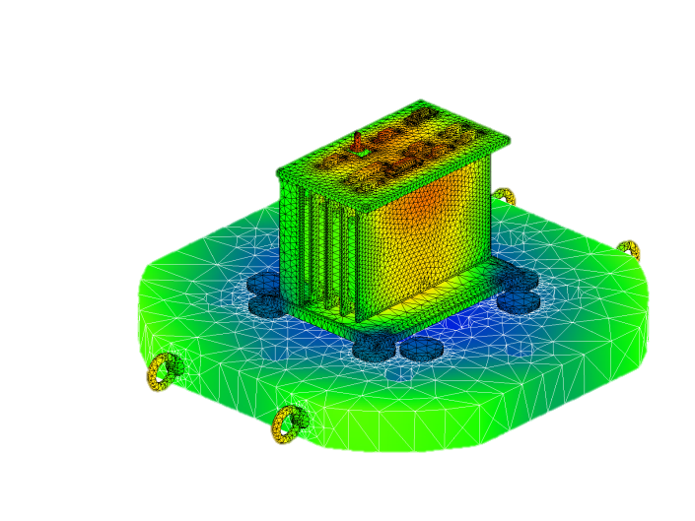
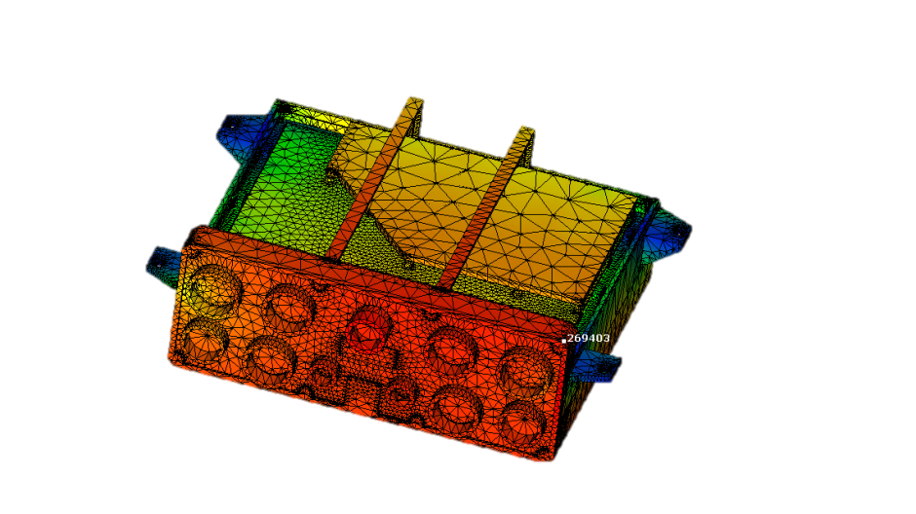
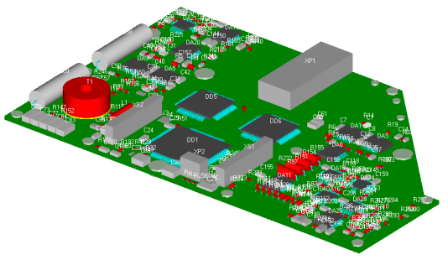
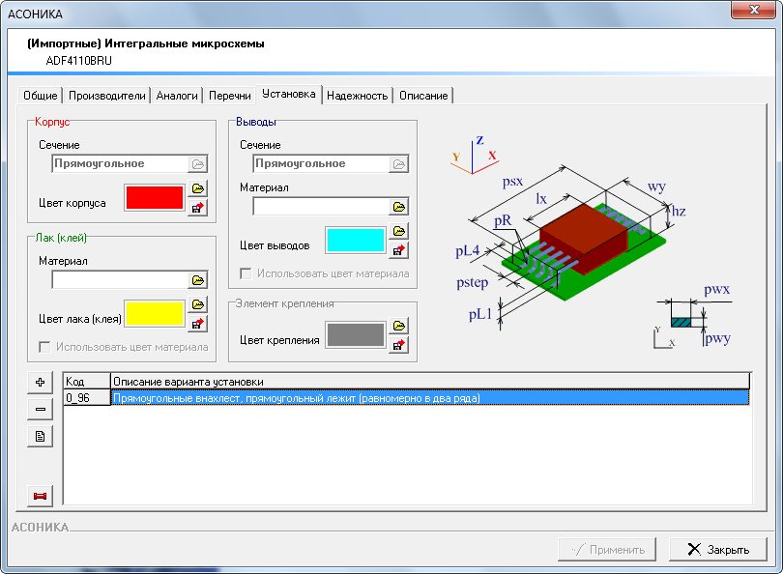
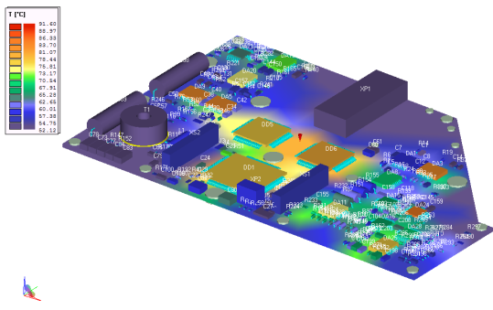
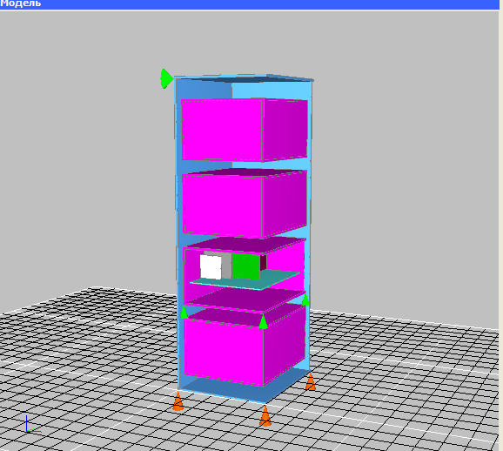
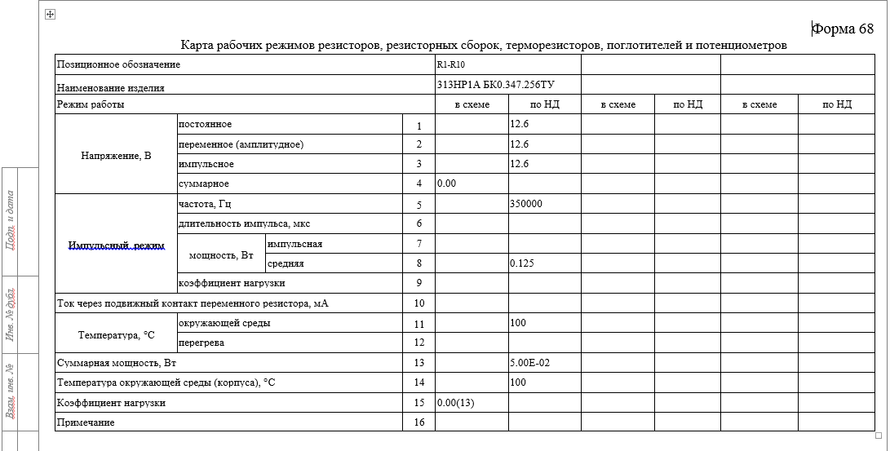
«ENERGOMODEL» technology
Interconnected subsystems of the ASONIKA system;
modeling of mechanical, thermal, electromagnetic processes;
reliability calculation;
formation of maps of operating modes;
Database.

Slide 3

«ENERGOMODEL» addresses three key problems of modern elements, devices, instruments for energy (EDIE)
prevention of possible EDIE operation failures at the primary design stages
time and cost reduction of the EDIE designing
document flow automation and an electronic model of EDIE within the framework of CALS-technologies

Slide 4
What is «ENERGOMODEL»?
ENERGOMODEL is the computer simulation for external thermal, mechanical, electromagnetic and other influences before any device manufacturing. This is an advanced cost & time cut approach in equipment design and production along with top quality and reliability standards.
The modeling is based on the Automated System for Assuring the Reliability and Quality of the ASONIKA Equipment (www.asonika-online.ru)

Slide 5
«ENERGOMODEL» as future key solution
PDM system
Data management
Subsystems
(ASONIKA)
heat;
Database
Perspective subsystems
electronic components and materials
electrical specification
mechanics
reliability
mode maps
pressure
precipitation
sand
humidity
thermal
mechanical
reliability
electromagnetic
radiation resistance

Slide 6
Reference data base of EDDE Automated design
MATERIAL PARAMETERS
(metals and alloys, non-metals, varnishes and glues, other)
PARAMETERS OF ELECTRONIC COMPONENTS (EC)
(Russian and foreign element base)
MODELS OF EC INSTALLATION ON THE PRINTING BOARD
MODELS OF THE EC EFFICIENCY INDICATORS ANALYSIS
EC WORKING CARDS
ADDITIONAL DIRECTORS AND TABLES

Slide 7
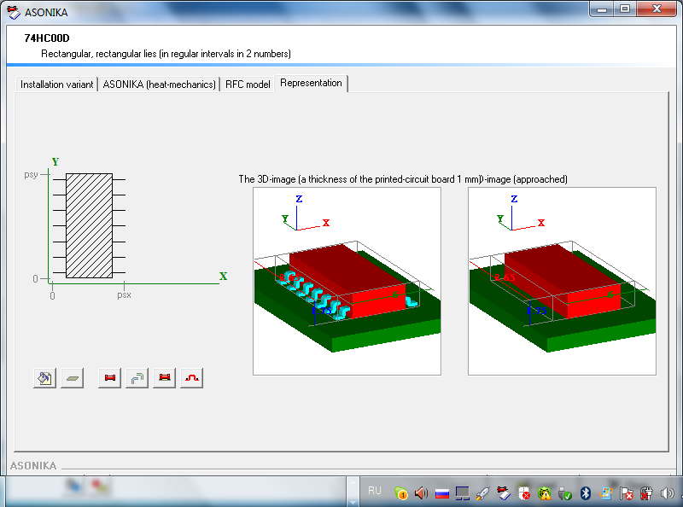
Notes:
7

Slide 8
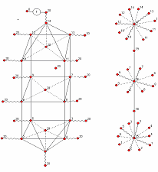
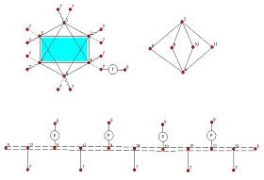
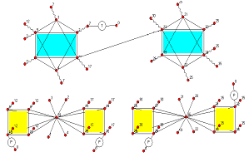
Energomodel-t: analysis and thermal descriptions of EDIE constructions
automation of non-standard EDIE structures designing with regard to their thermal conditions;
analysis of stationary and non-stationary thermal modes of EDIE;
determination of the temperature of selected isothermal volumes, EC temperatures, temperature fields and integral temperatures;
current database application with reference geometric and thermal parameters of EC and structural materials;
graphical input of in-data for constructions.
Thermal models of typical structures, synthesized automatically:
  high-rise cabinet
cassette type unit
modular unit

Slide 9
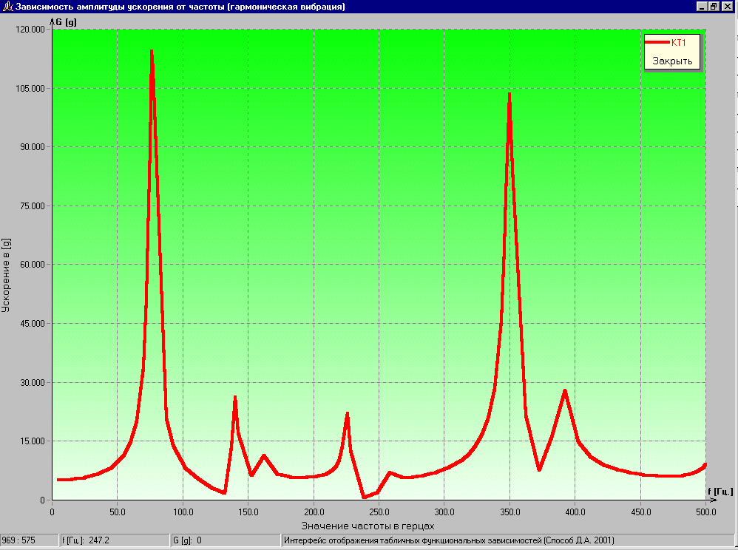
Energomodel-m: analysis of EDIE blocks of typical designs on mechanical impact
to calculate on the following types of mechanical effects
  harmonic vibration
  random vibration
  hit
  linear acceleration
  deflection
  block analysis
  cassette
  bookcase
  cylindrical type
  cabinets
Block type
Cassette type
Cylindrical block

Slide 10
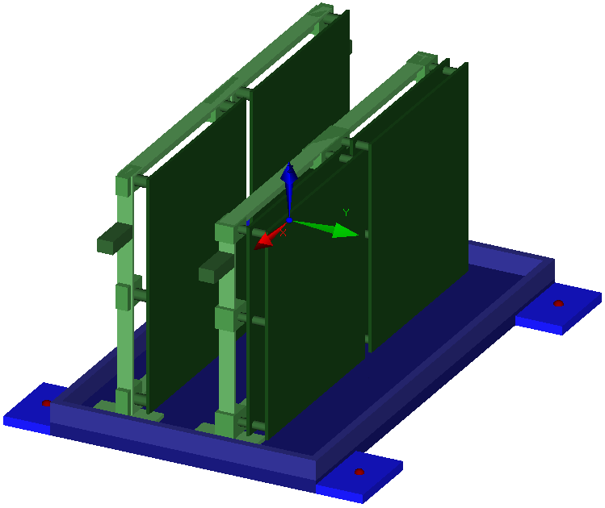
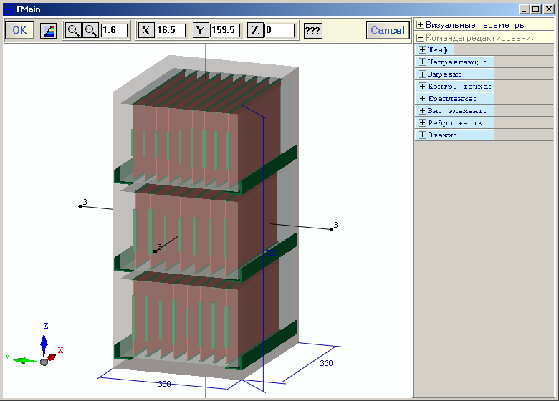
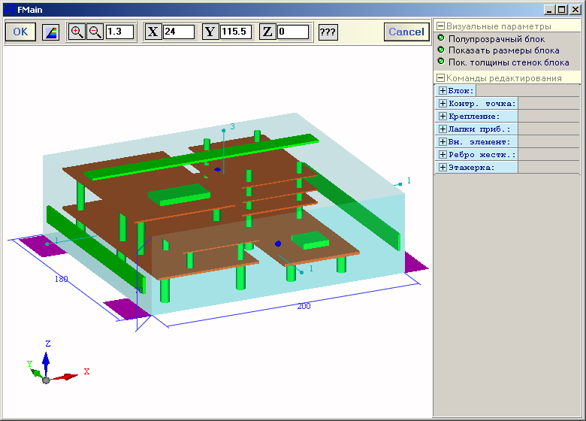
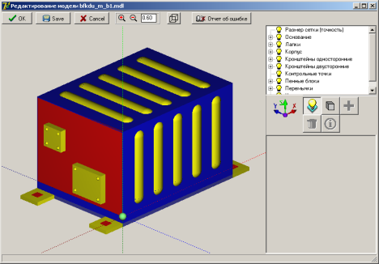
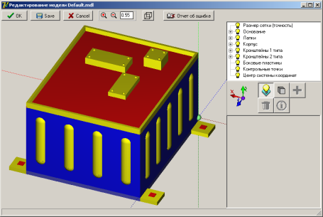
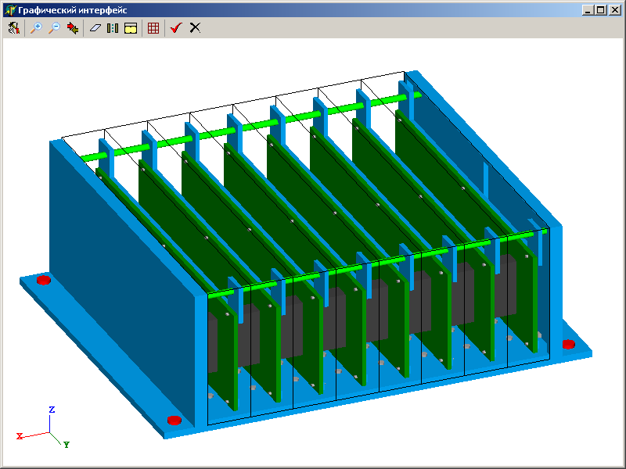
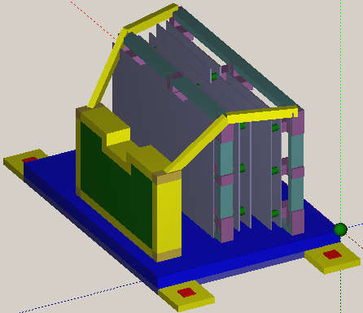
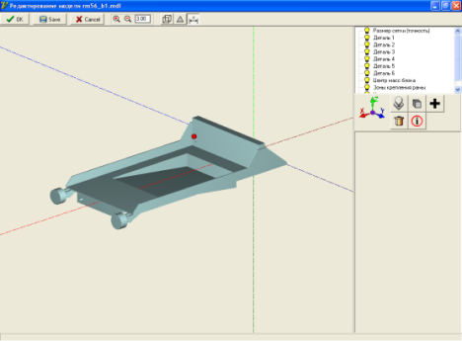
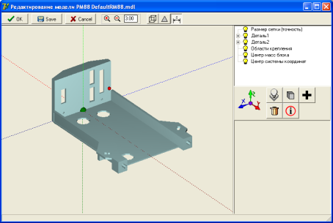
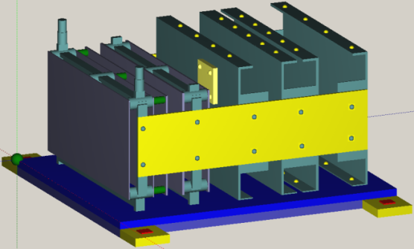
Energomodel-m: analysis of EDIE blocks typical designs on mechanical impact

Slide 11
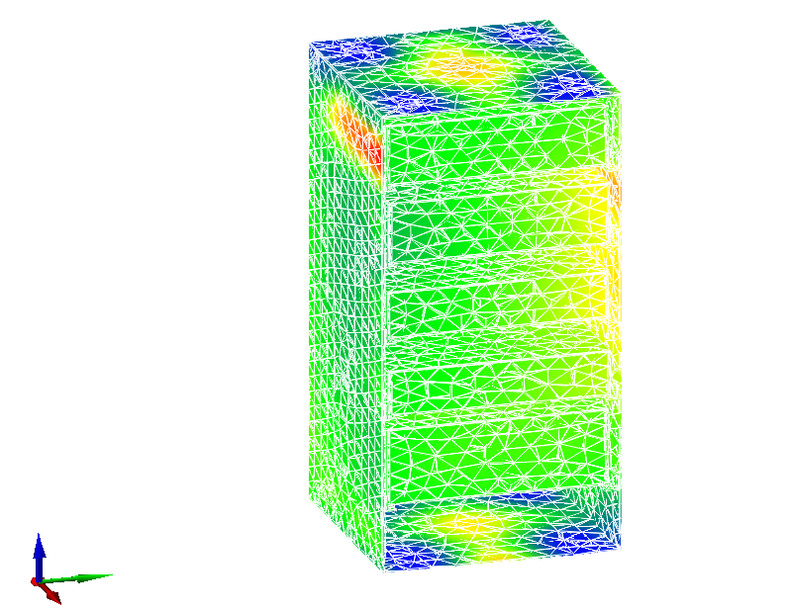
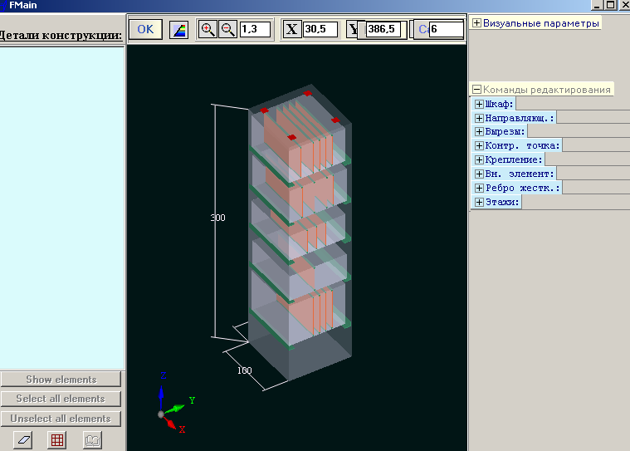
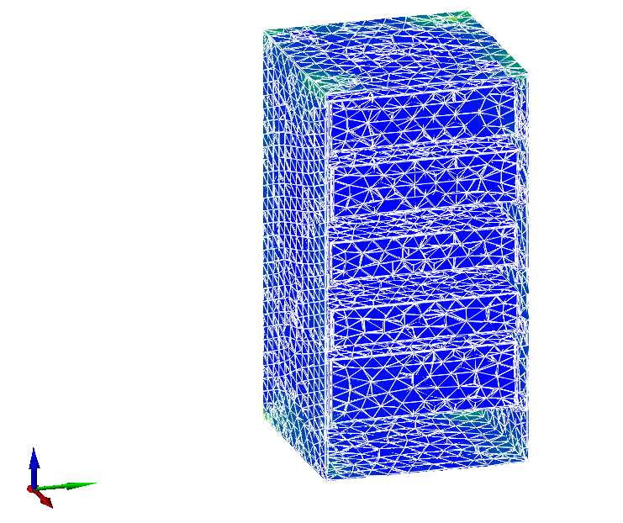
Energomodel-m-cabinet : analysis of cases and EDIE racks typical designs of on mechanical impact
Accelerations in the cabinet model
The technology is to calculate the mechanical characteristics of EDIE typical cabinets and pillars exposed to harmonic and random vibrations, single and multiple shocks, linear accelerations. The graphical interface of input-output information allows for input of the structure according to the existing assembly drawing, as well as displaying the results of the calculation of the structures mechanical characteristics. Implemented local database has physico -mechanical parameters of structural materials necessary for the calculation of mechanical characteristics.
Stresses in the cabinet model

Slide 12
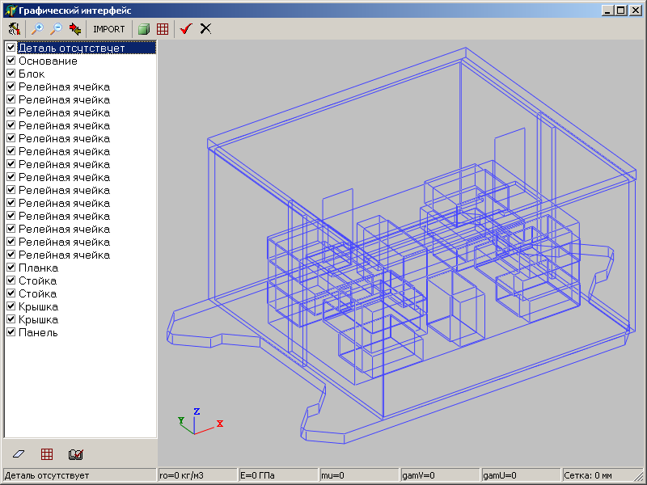
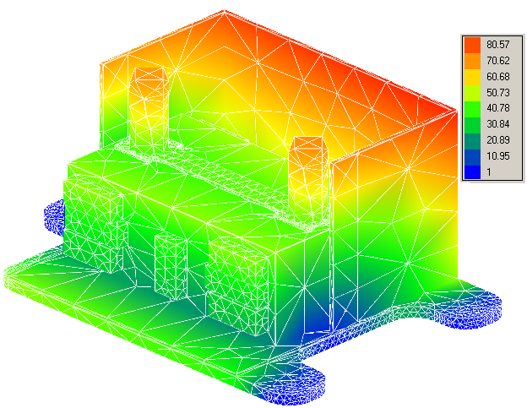
Energomodel-m-3d: strength and reliability analysis of arbitrary volume constructions of EDIE creations in proengineer, solidworks systems and other cad-systems in iges, step and sat formats, to mechanical applications
1. Import of structure geometry (IGES, STEP, SAT)
2. Setting Material Attributes and Grid Parameters
3. Setting the boundary conditions for fixing the device
4. Building a finite element model of the device
5. Setting the parameters of mechanical action
6. Simulation
7. Analysis of simulation results

Slide 13
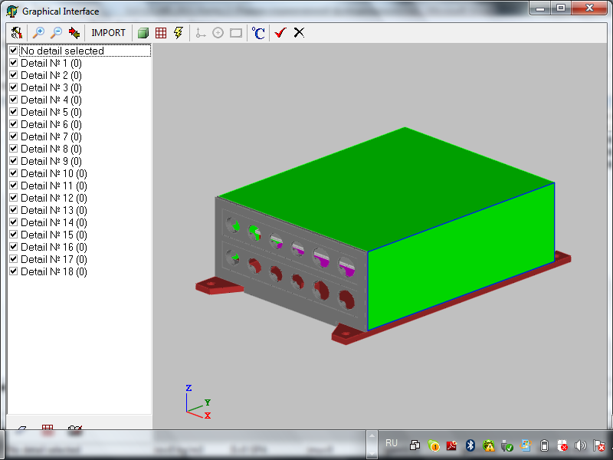
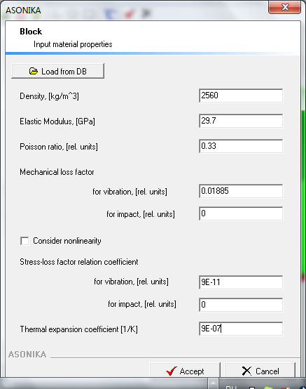
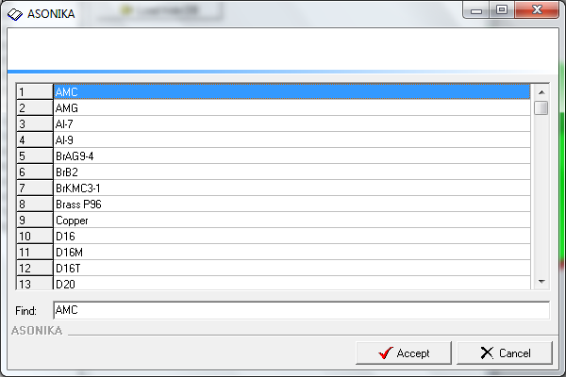
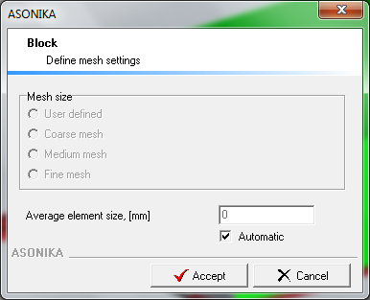
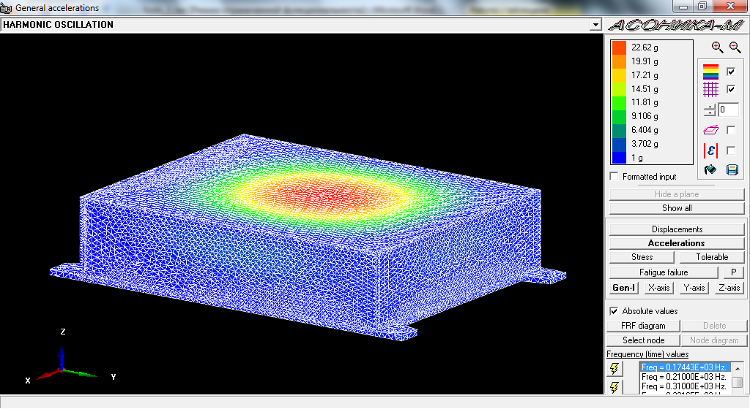
Arbitrary constructions

Slide 14
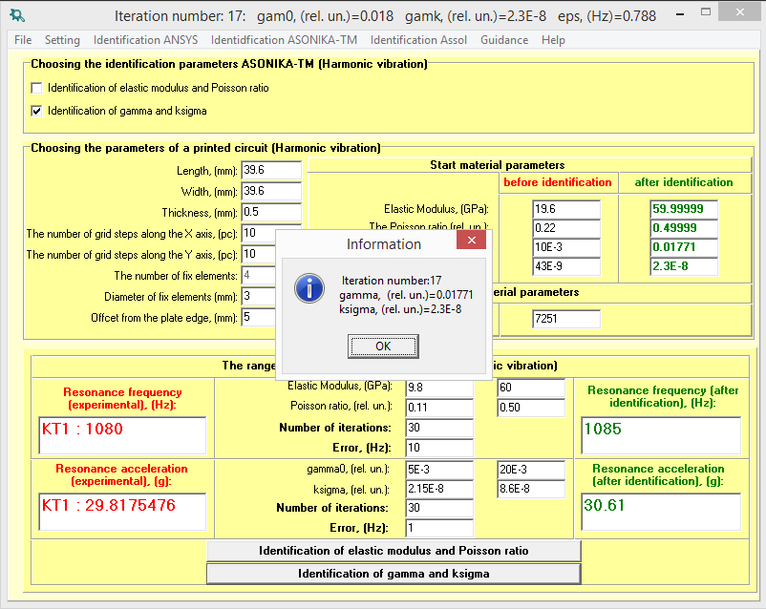
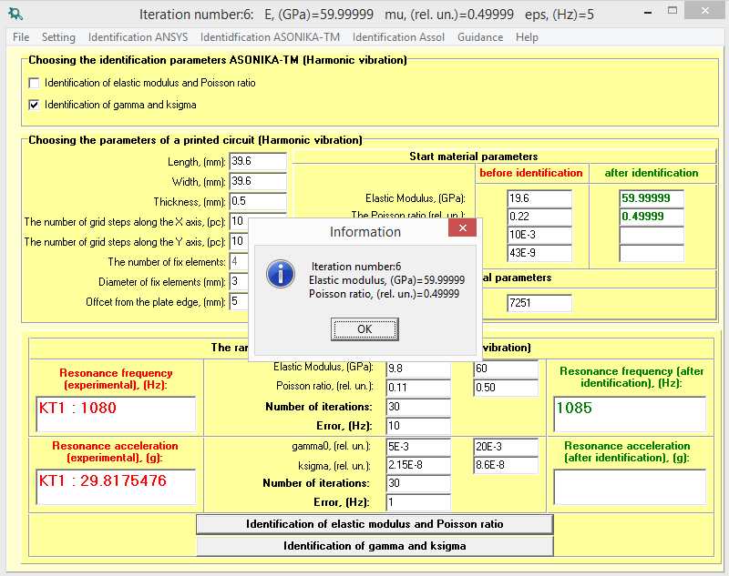
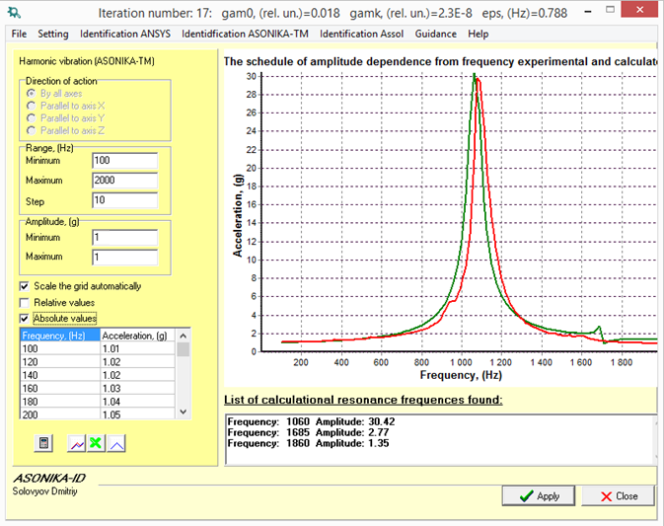
Energomodel-id: identification of physical-mechanical parameters of models of EDIE
The technology is for the identification of physicomechanical and thermophysical parameters of EDIE models and, above all, of: the elastic modulus of the material, the Poisson’s ratio of the material; mechanical loss coefficient (MLC) at the starting point; the coefficient of dependence of the MLC from mechanical stress.

Slide 15
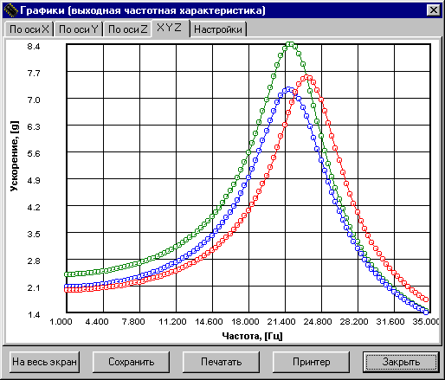
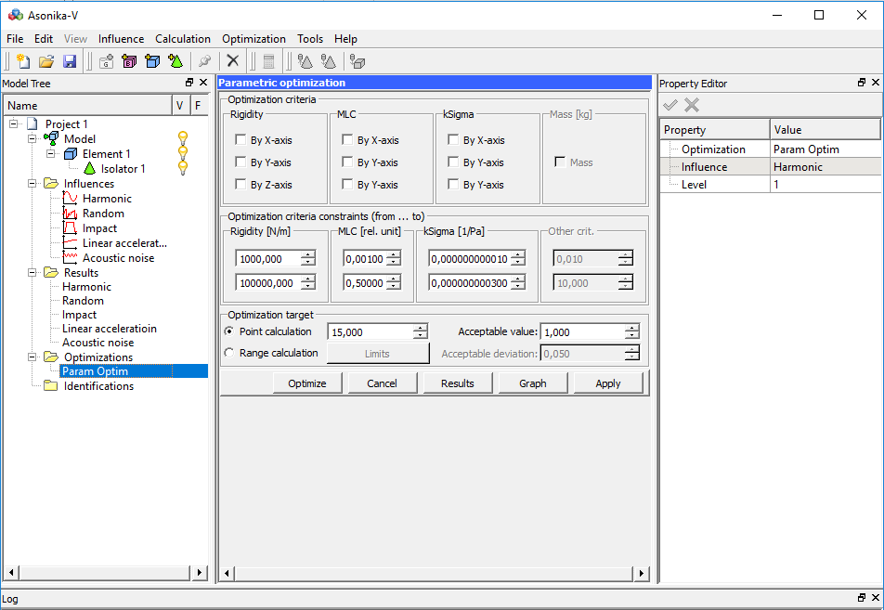
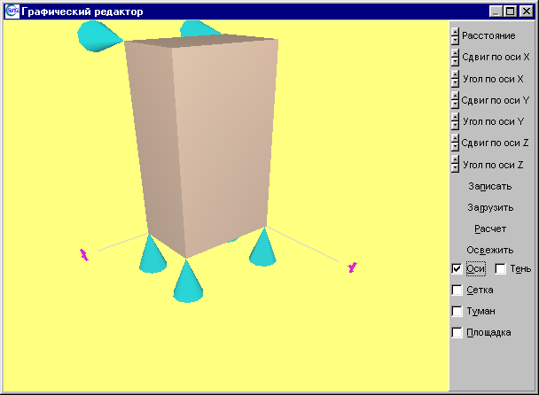
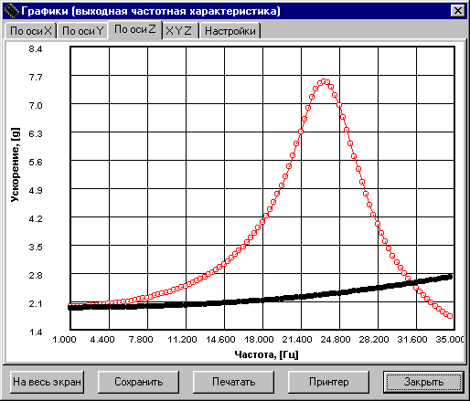
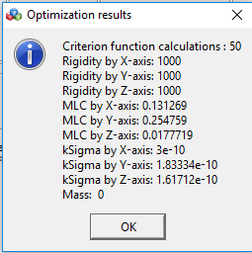
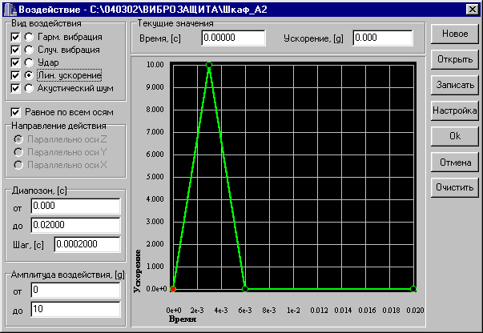
Energomodel-v: analysis and maintenance of resistance to mechanical impact of EDIE constructions on vibrizers
- analyze the mechanical characteristics of the cabinets, racks and EDIE blocks installed on vibrationinsulators, when exposed to harmonic vibration, random vibration, shock loads, linear acceleration, when exposed to acoustic noise and to make decisions based on the obtained mechanical characteristics in order to ensure the stability of EDIE under mechanical stress.
- identify the parameters of vibration isolators, as well as the optimization of their parameters in order to reduce the load on the structure.
Graphic input design and impact
The results of optimization of vibration isolator parameters
Simulation results

Slide 16
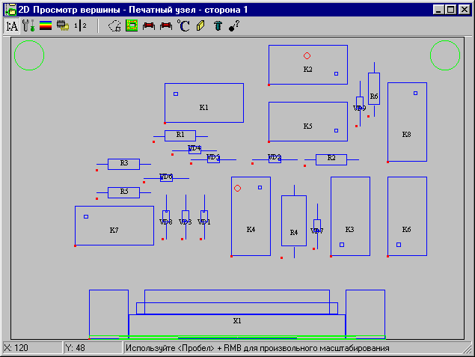
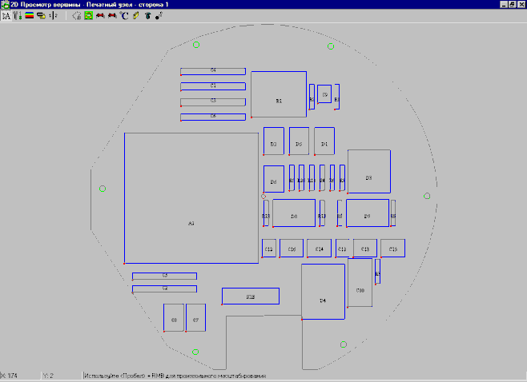
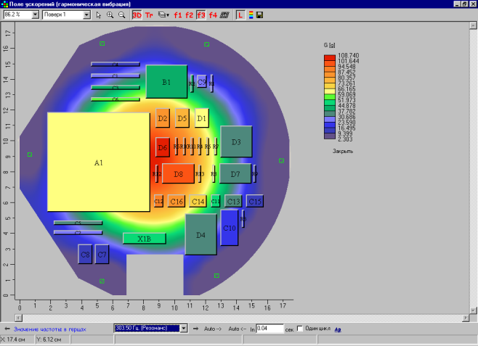
Energomodel-tm: modeling of thermal and mechanical processes in printed units of EDIE
- analysis of stationary and non-stationary thermal processes in the printing units (PU);
- analysis of mechanical processes in PU under the influence of vibrations, shocks, linear accelerations and acoustic noise, taking into account:
- the heating temperature of areas PU,
- ambient temperature
- aerodynamic air resistance;
- non-linearity of mechanical parameters of materials of printed circuit boards;
- analysis of the fatigue strength of the findings of radioelements.
The results of thermal modeling of round PU
Raw geometric data
Rectangular PU
Round PU

Slide 17
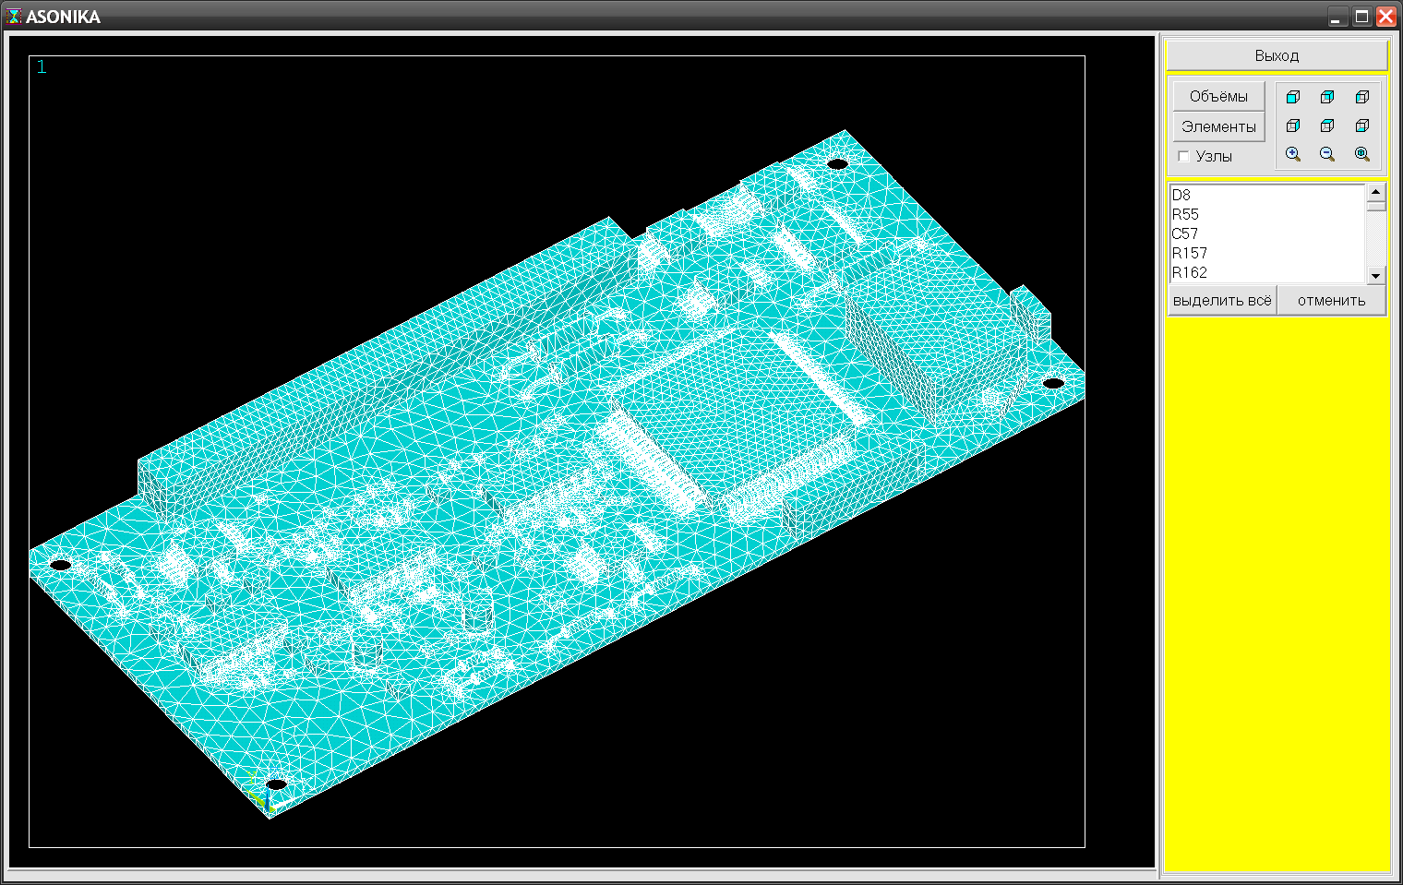
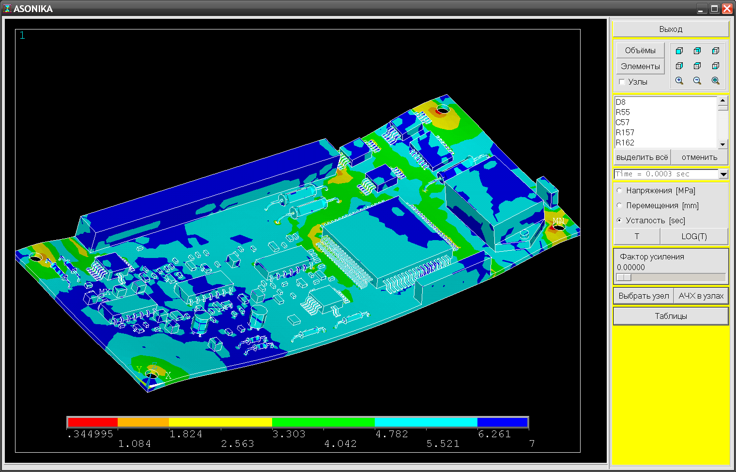
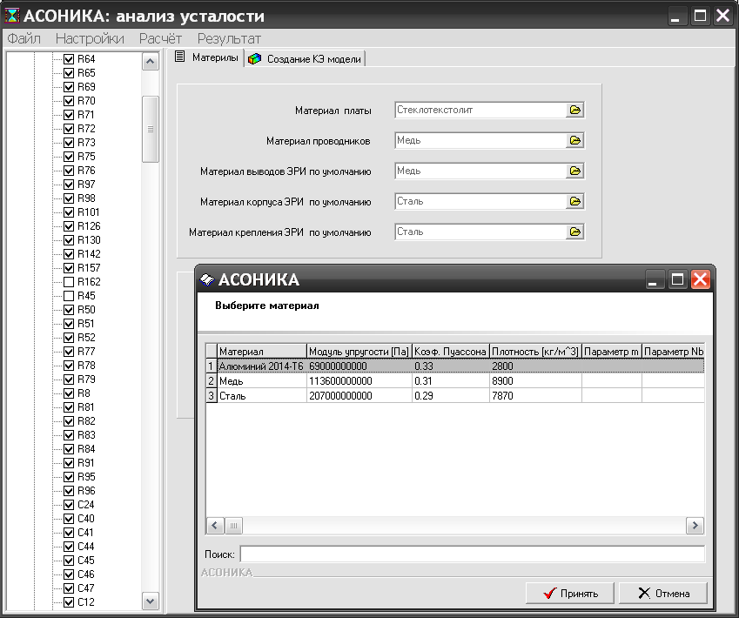
ENERGOMODEL-UST: analysis of the fatigue strength of structures of printed circuit assemblies and EC EDIE under mechanical stress

Slide 18
Energomodel-r: automated filling of the working modes cards of electronic components EDIE
«ENERGOMODEL-R» is to facilitate and accelerate the filling of the operating modes of electronic components (EC) cards.
- It allows the automatic filling of EC operating modes maps based on the list of EC entered by the user, and a database containing the maximum permissible values of EDIE parameters according to technical conditions, including in the form of graphical and analytical dependencies. At the same time, the list of EC is entered both manually and automatically from files prepared in the PCAD system.
Card output 68 operating modes of resistors, resistor assemblies, thermistors, absorbers and potentiometers

Slide 19
«ENERGOMODEL-B» analyzes cabinets, blocks, printed electronics EDIE, electronic components (EC) to solve the following tasks:
1) determination of all EC reliability indicators;
2) the rationale to assess the EDIE reserving efficiency.
The technology supports the following types of redundancy:
1) passive backup with a constant load;
2) active loaded redundancy;
3) active unloaded reservation;
4) active lightweight backup.
The simulation can show operational failure rates, probability of failure-free operation, and average time-to-failure operation of the EDIE.
Service maintenance technology includes:
1) a database with mathematical models for calculating the values of the operational intensity of EC failures and the values of the coefficients included in the models;
2) a database editor that allows you to replenish the EC nomenclature, as well as change all the values of the coefficients and mathematical models.

Slide 20
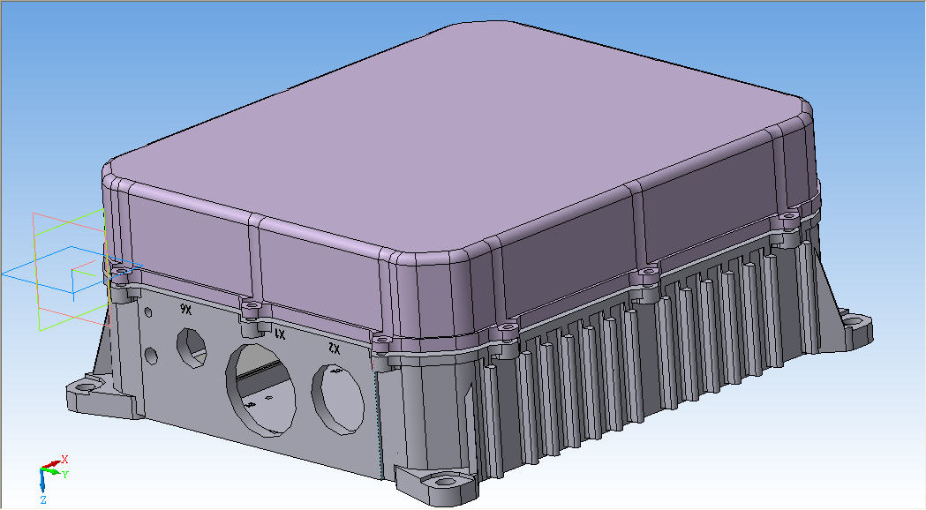
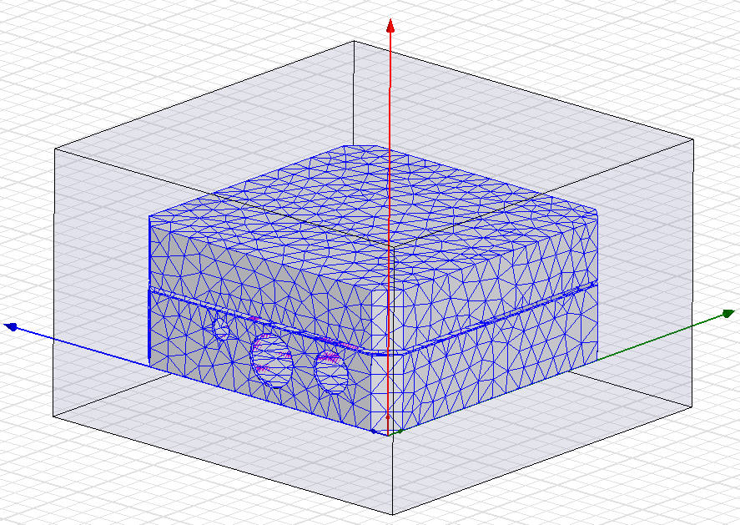
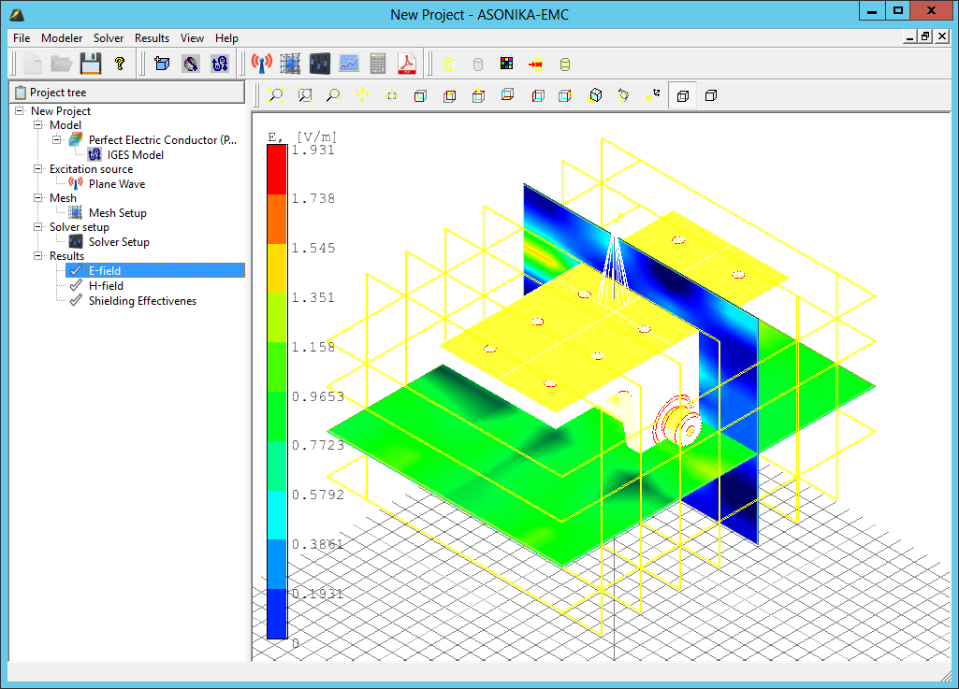

Energomodel-emc: analysis and provision of electromagnetic compatibility EDIE

Slide 21





Example of management of design data contained in a virtual project
  P-CAD layout
  Design documentation in the PDM system
  Assembly drawing in AutoCAD
  Specification
  Technical conditions
21

Slide 22





Example of a virtual mocket
  Project documentation in the PDM system
  Modes map
  Model of electrical processes
  The results of a comprehensive analysis of physical processes (part of the analysis of the field of mechanical accelerations is presented)
  3D model
22

Slide 23
THANKS FOR ATTENTION!
www.energomodel.com
energo@energomodel.com

